Slide 1
AN AGENT-BASED APPROACH TO CONSUMPTION, INEQUALITY IN DISTRIBUTION AND SUSTAINABILITY OF A LIMITED SOURCED ENERGY-DEPENDENT SOCIETY
Suman Saurabh (saurabh@utexas.edu); Carey W. King (careyking@mail.utexas.edu, @CareyWKing); Larry Lake (larry_lake@mail.utexas.edu); Michael Marder (marder@chaos.utexas.edu); Eric Abelson (abelson@mail.utexas.edu); Louis Merceron (louis.merceron@ens-lyon.fr)
Background and Motivation
The study of human and nature dynamics is a study of a complex system where, simple algorithmic actions by agents (human and nature) with other agents at “micro/individual” scale leads to complex phenomena “emergence” at macro scale; much like simple molecular collision leads to the emergence of pressure in a closed vessel.
In studying the ever-increasing demand for energy/resources by humans and their substantial footprint on the earth, many researchers over the year have stated the belief that such a trend is not sustainable. One model which discusses two major issues with sustainability of societies HANDY (Human and nature dynamics) model proposed by Moteshharei et al., (2014). Two issues that lead to instability of societies in the model are, first, rapid consumption of resources before they can regenerate and second, and unequal distribution of the resource leading to higher death rate of resource extracting agents.
Data and Methodology
References
Consumption, Govt., Capital Formation, ΔInventory (N)
Conclusions

Slide 2
Blank separator

Slide 3
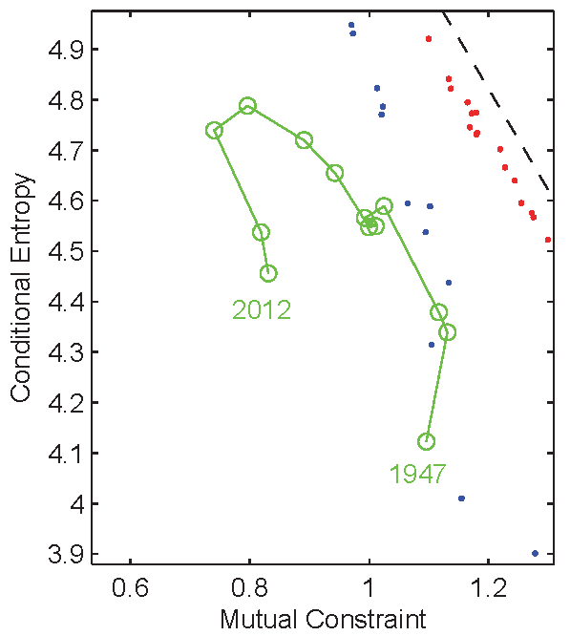
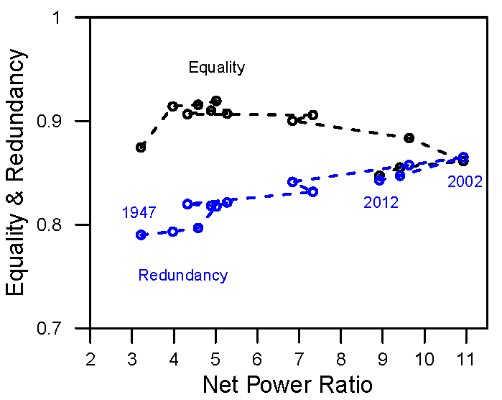
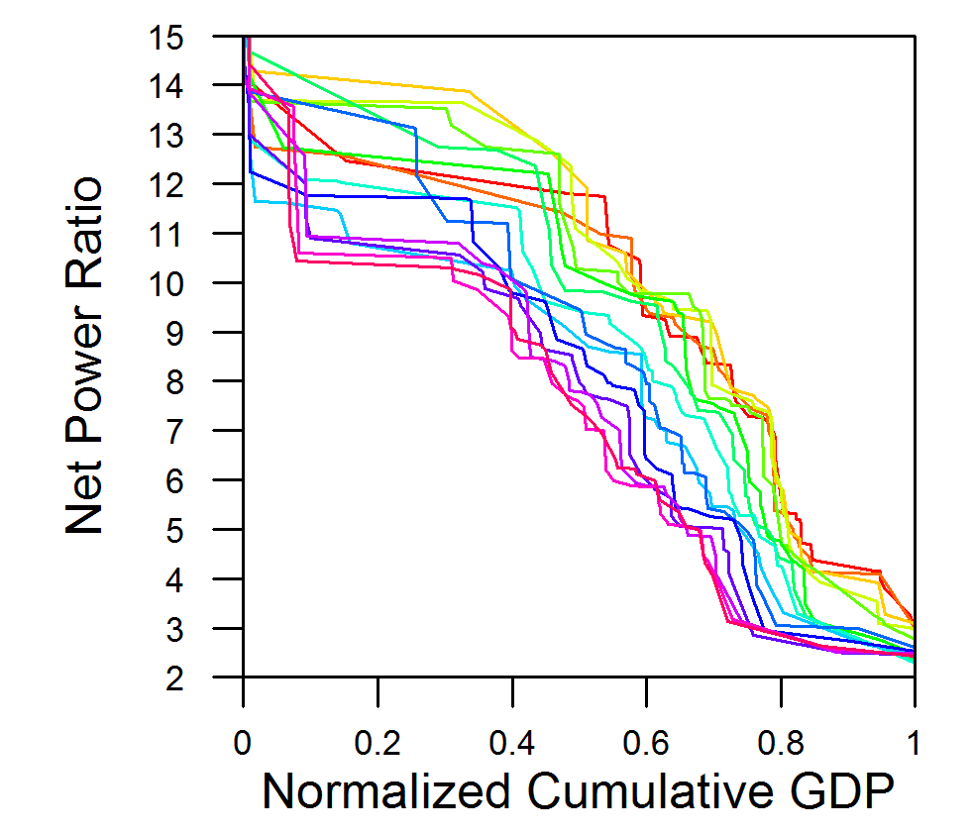
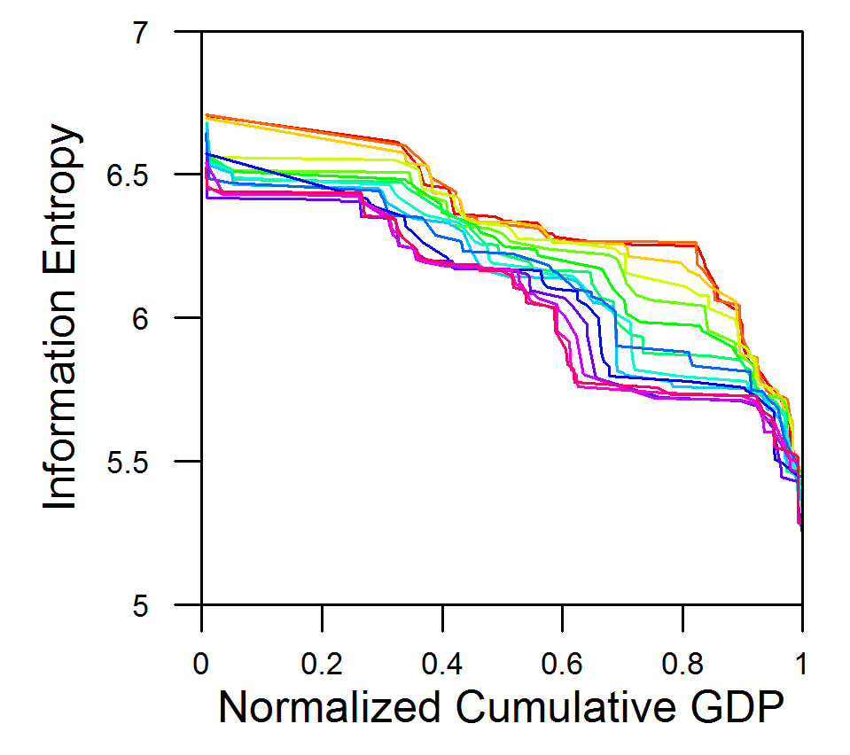
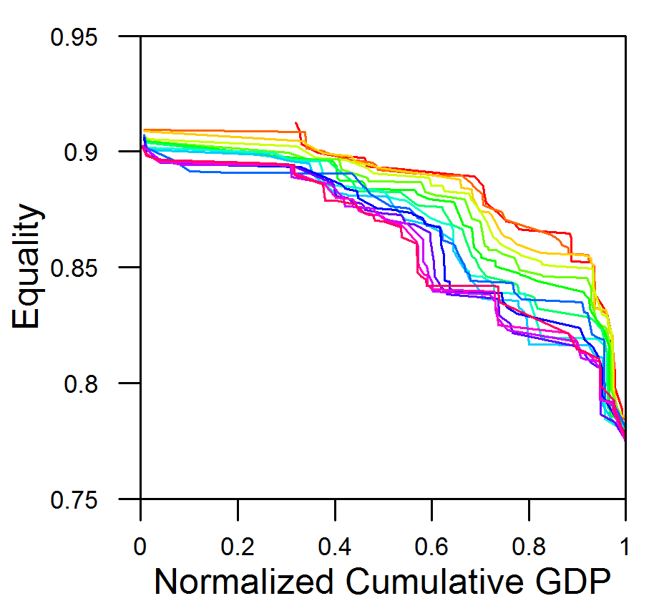
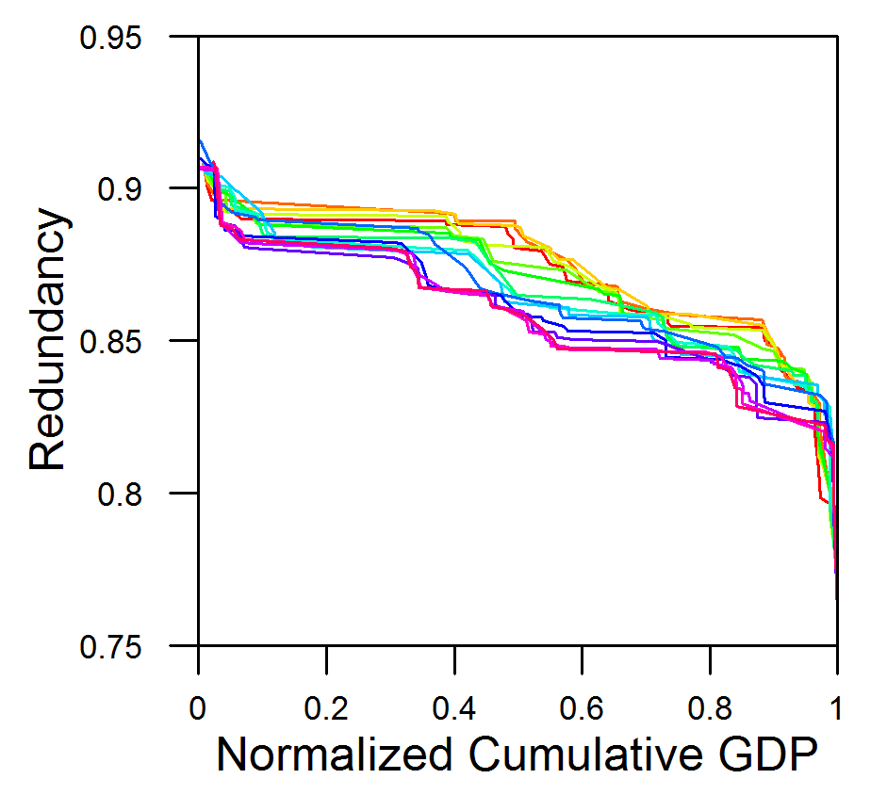
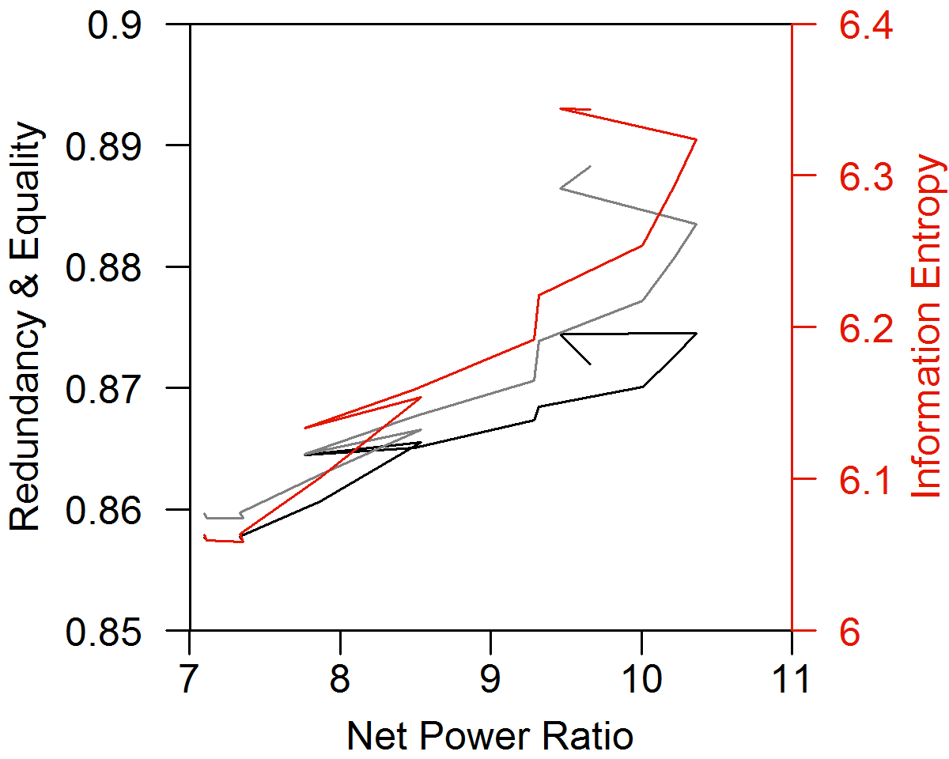
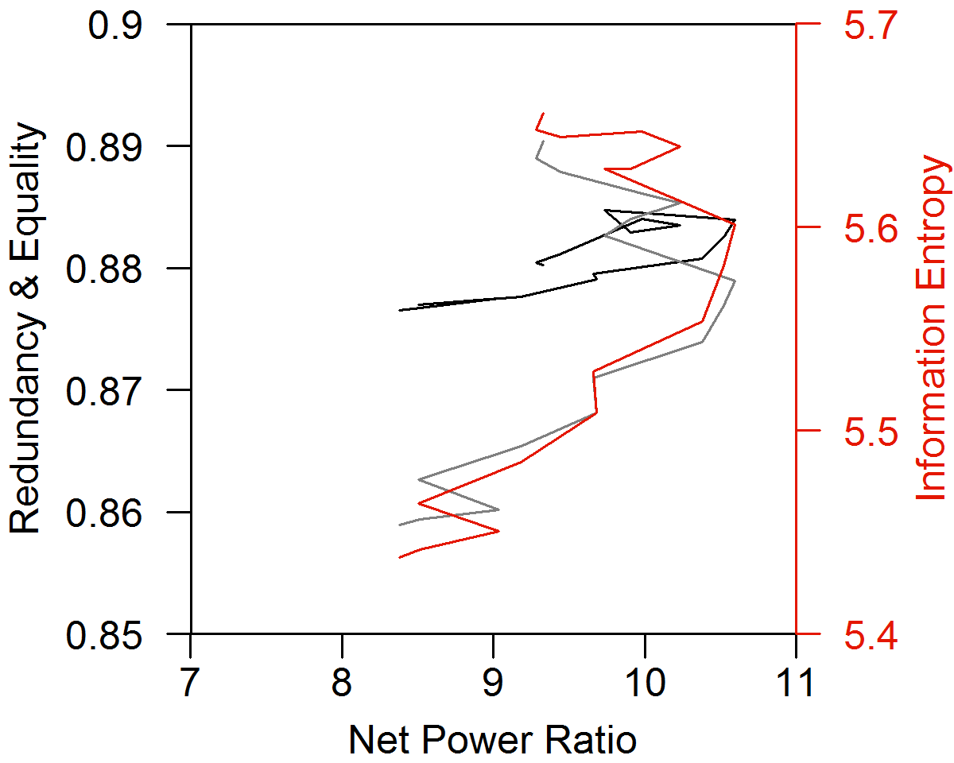
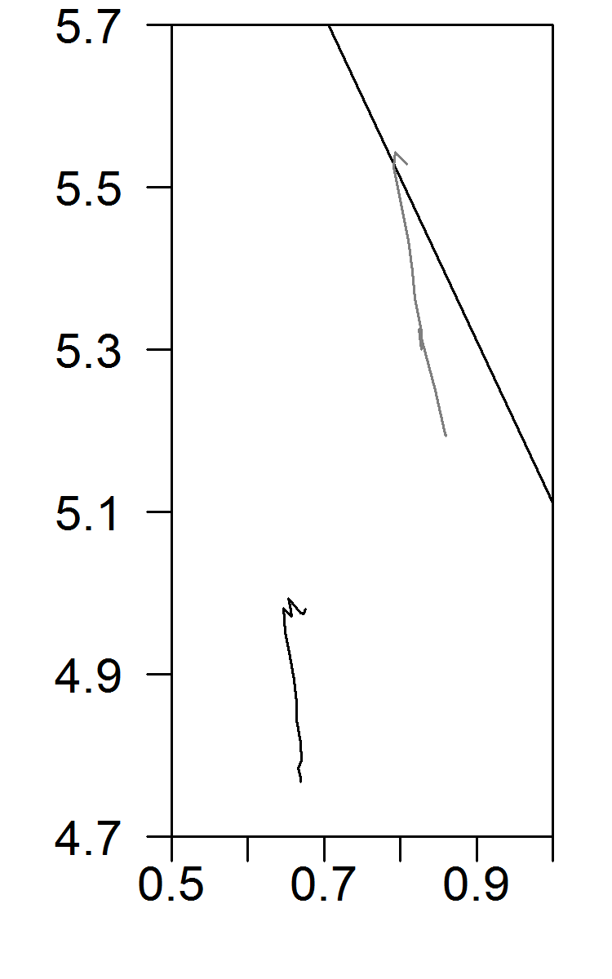
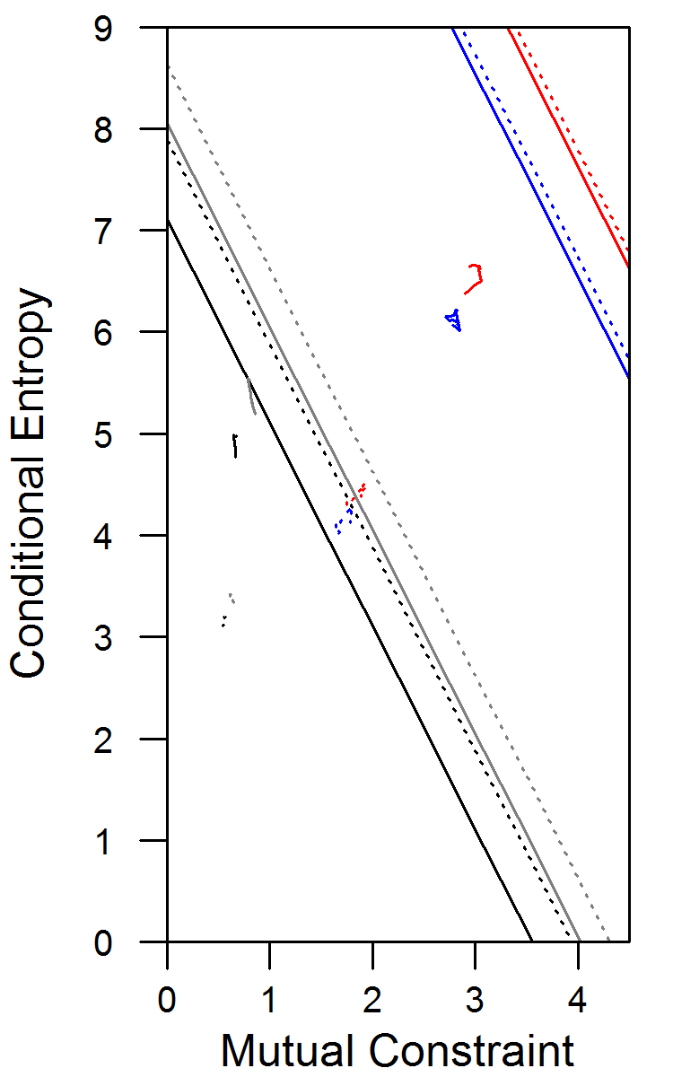
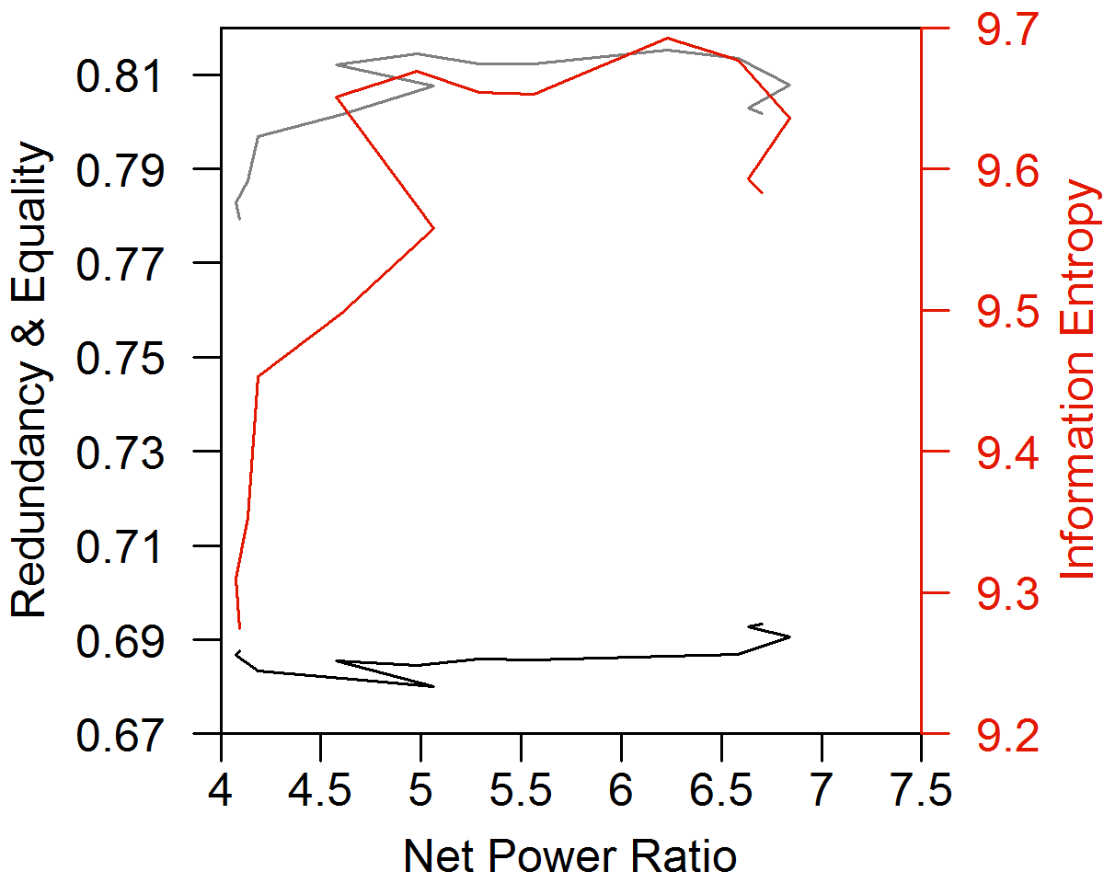
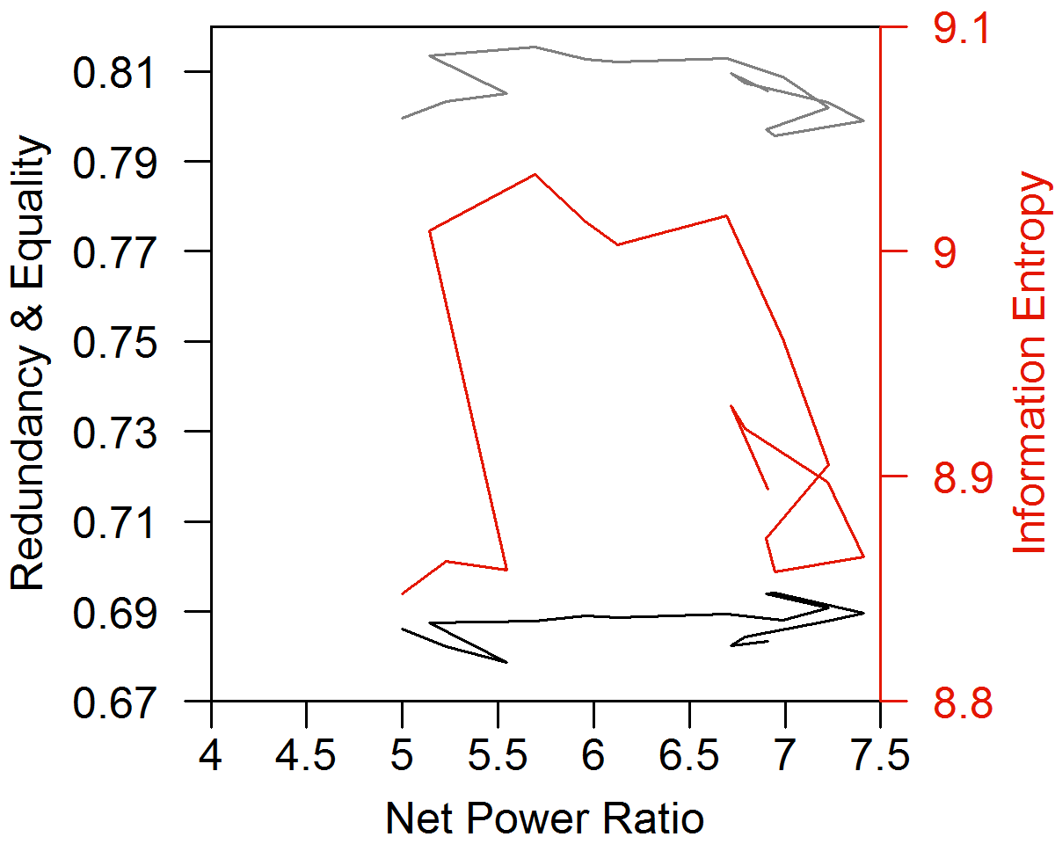
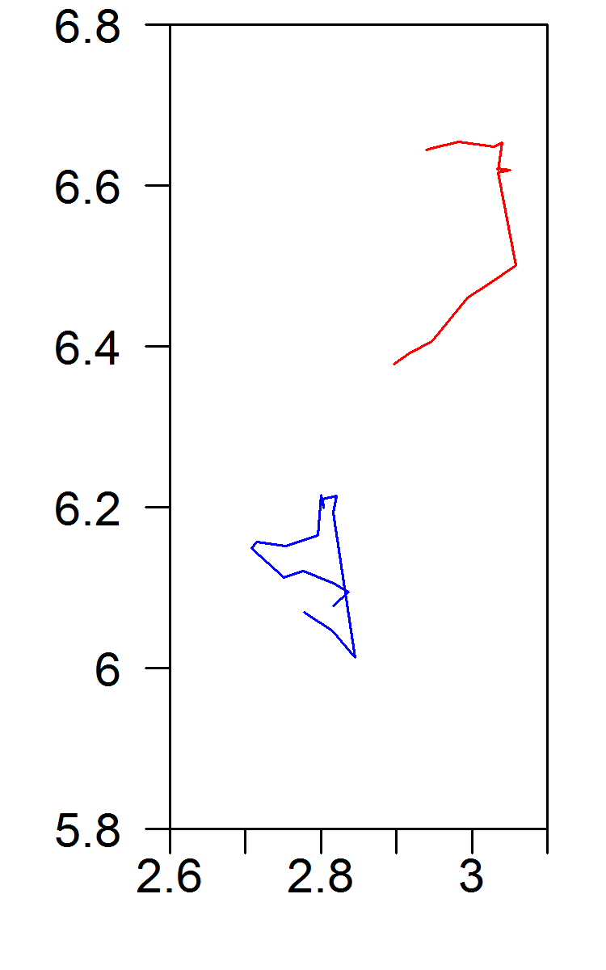
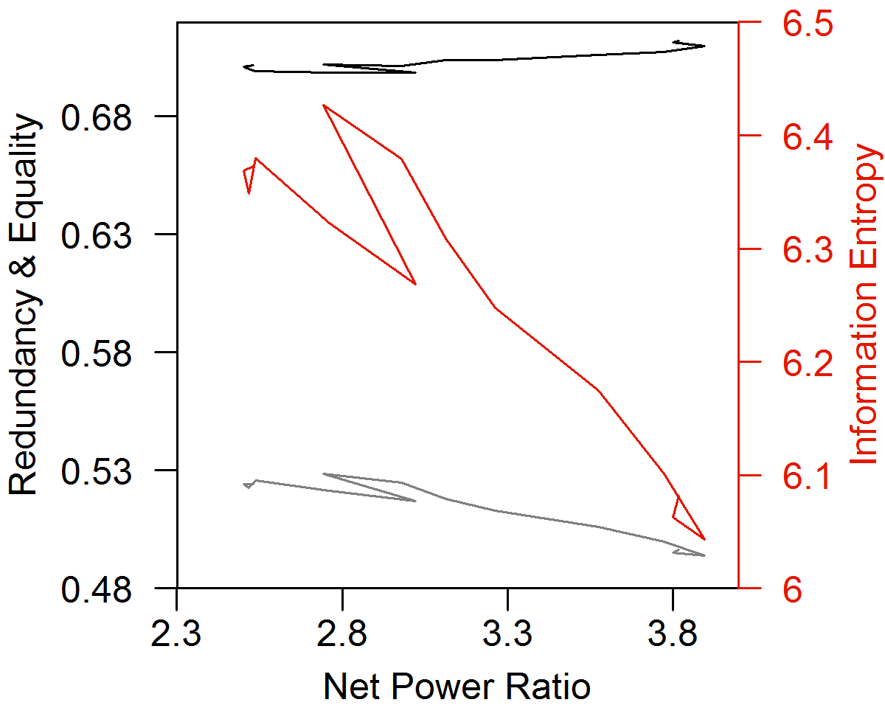
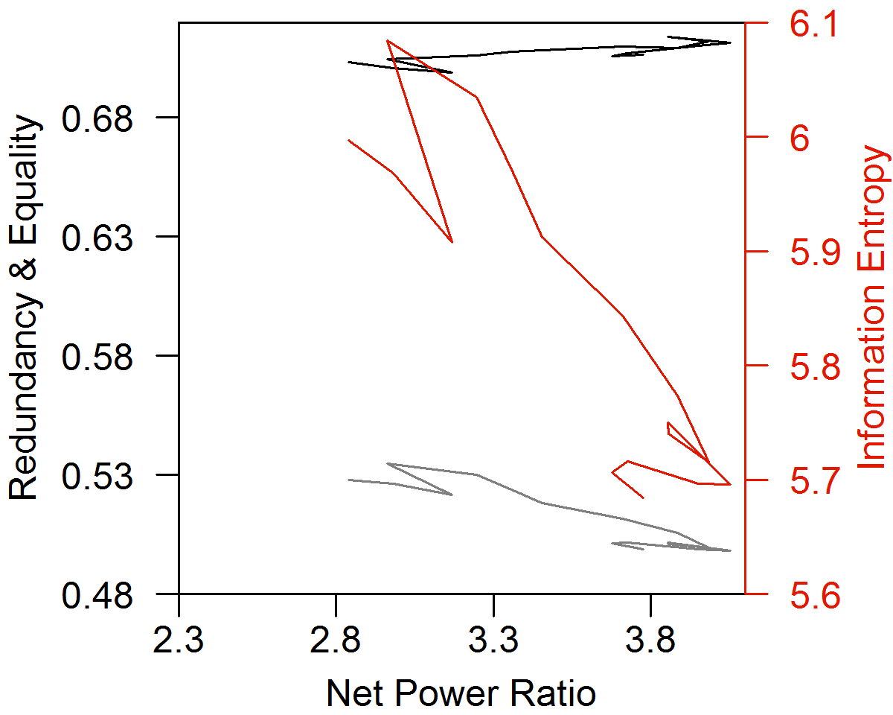
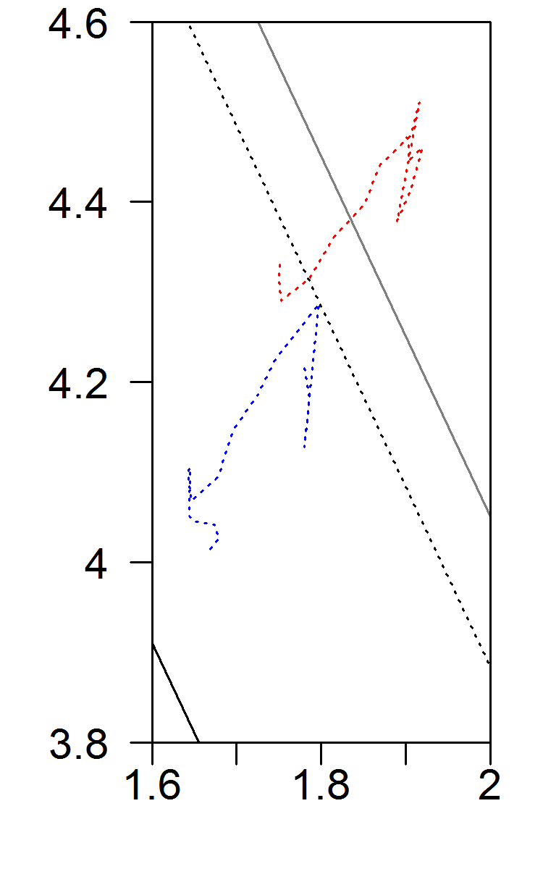
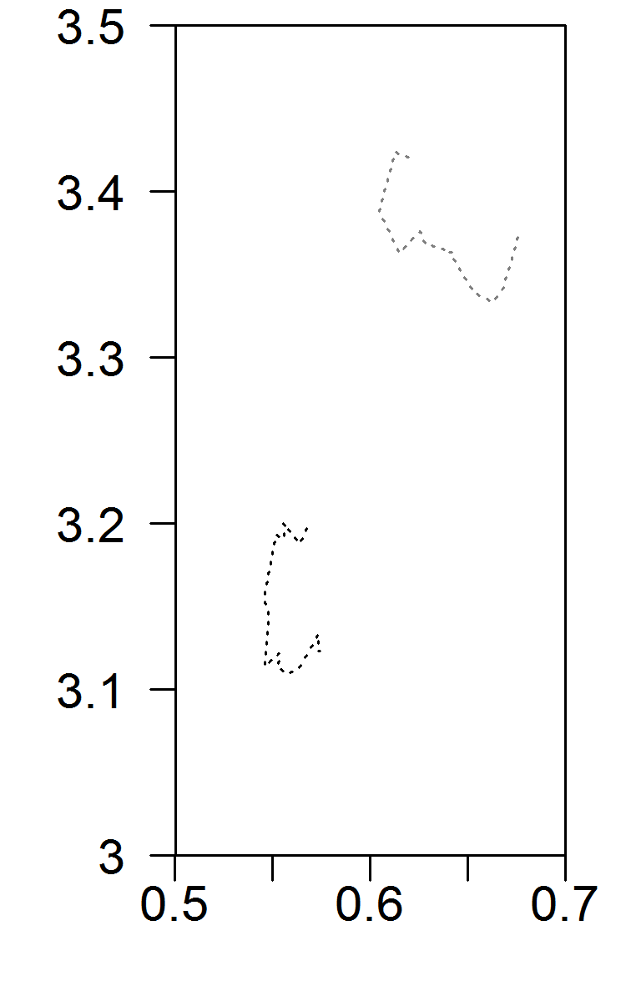
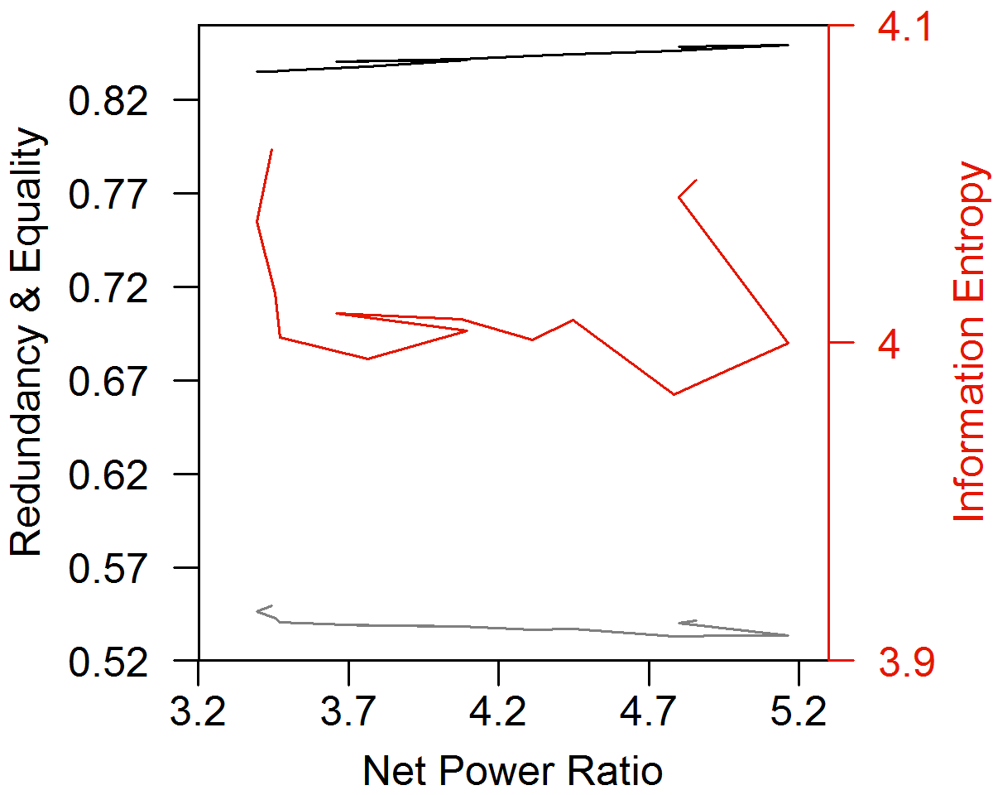
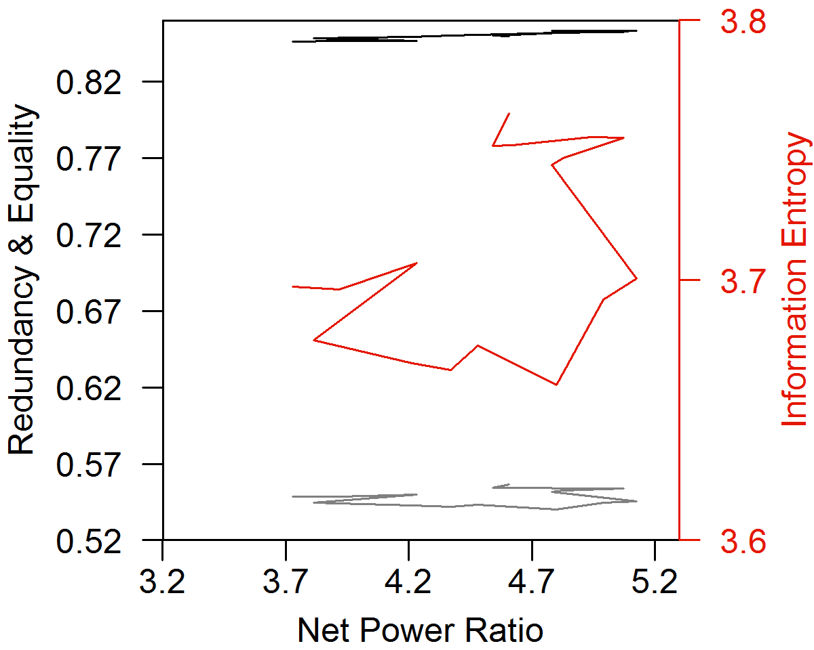
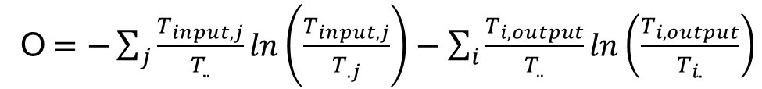
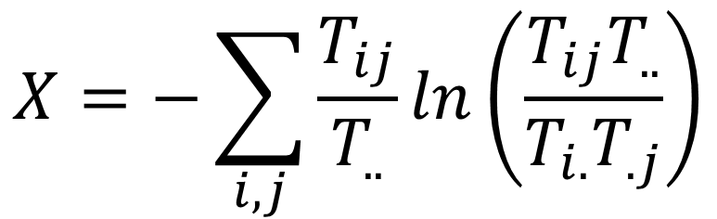
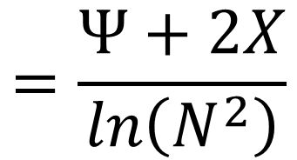
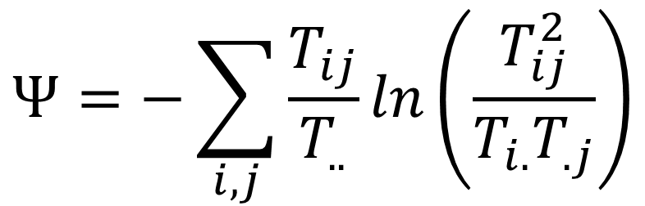
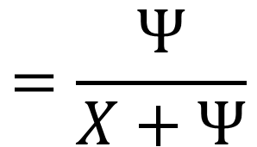
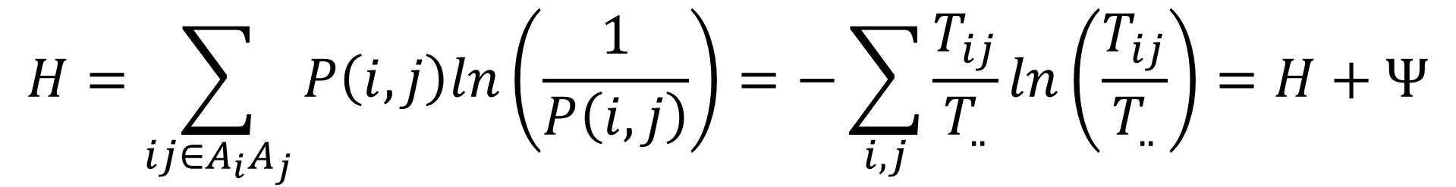
The Network Structure of the World Economy: Using the World I-O Database
Carey W. King (careyking@mail.utexas.edu, @CareyWKing)
Background
Previous Results (U.S. only: 1947-2012)
Scientists from multiple disciplines posit that the structure of complex systems is linked to the cost (or “net energy”) of and rate of resource (energy) consumption. The purpose of this research is to understand the relationship between the structure of the economy and the cost of “core” inputs of food and energy. Structure is measured via information theory metrics as used by Robert Ulanowicz to understand food webs, and as adapted by King (2016) to analyze economic input-output tables. The cost of energy and food is measured as the spending by food and energy economic sectors divided by net economic output (=gross domestic (or world) product), and the “net power ratio” is the reciprocal of that cost.
King (2016) showed three phases of structural change from 1947–2012 that relate to the rates of change of both (1) energy consumption and (2) the Net Power Ratio (= GDP / spending by food and energy sectors).
Table 1. Rate of change of information theory metrics of the U.S. I-O tables show 3 phases from 1947-2012.
Metric | Rate of Change (%/yr)
 | 1947 –1967 | 1967 –2002 | 2002 –2012
Energy Consump. | +4.1 | +1.9 | -0.3
Net Power Ratio | +2.8 | +3.4 | -1.8
Info. Entropy | +0.4 | -0.1 | -0.4
Equality | +0.3 | -0.2 | -0.2
Redundancy | +0.2 | +0.2 | -0.3
Conditional Entropy
Mutual Constraint
Data and Methodology
Figure 2. Information theory metrics of the U.S. I-O tables from 1947-2012 [King (2016)].
The method assumes the economy is a network of flows (= sector-to-sector transactions) among nodes (sectors). Data come from the World Input-Output Database (WIOD, http://www.wiod.org/). Releases 2013 and 2016 of the WIOD respectively harmonize economic data for 41 and 44 countries across 35 and 56 sectors from 1995 to 2011 and 2000 to 2014. The information theory metrics derive from calculating mutual constraint (X) and (joint) conditional entropy (Ψ), the sum of which is total information entropy (H).
New Results: WIOD Release 2016: 2000-2014
Japan
USA
(a)
USA
2000
(b)
USA
2000
(c)
USA
2000
Spain
(d)
2000
Spain
Spain
2014
Spain
Canada
China
2014
Canada
China
2014
China
China
2014
Canada
Canada
Brazil
Brazil
Brazil
Rest of World
Brazil
1/16 | 1/16 | 1/16 | 1/16
1/16 | 1/16 | 1/16 | 1/16
1/16 | 1/16 | 1/16 | 1/16
1/16 | 1/16 | 1/16 | 1/16
Ψ_{max} = ln(N²)
Hierarchy = 0
Equality = 1
Efficiency = 0
Redundancy = 1
Rest of World
Rest of World
Rest of World
Redundancy
Redundancy/Efficiency:
Describes flows
along edges
Figure 3. From 2000 to 2014, a higher fraction of world GDP came from countries with (a) lower net power ratio (or higher food and energy costs), (b) lower information entropy (H), (c) lower equality, and (d) lower redundancy. This trend seems largely due to globalization as the “Rest of World” and China account for much of the increased GDP since 2000 while having lower information theory metrics and net power ratio.
Hierarchy/Equality:
Describes flows through nodes
New Results: Worldwide Metrics at Different Boundaries
Conditional
Entropy (Ψ)
Hierarchy
Release 2016
Release 2013
Equality
X_{max} = ln(N)
Hierarchy = 0
Equality = 1
Efficiency = 1
Redundancy = 0
2000
Information
Entropy
1995
Information
Entropy
(A)
2000
 | 1
Ψ_{min} = X_{min} = 0
Hierarchy = 1
Equality = 0
Efficiency
 | 1/4
 |  | 1/4
 |  |  | 1/4
1/4
Country Metrics weighted by GDP
(no ins & outs)
Equality
Redundancy
2002
Release 2016
Mutual Constraint (X)
Redundancy
Equality
1995
2014
Figure 1. For any set of flows within a network, T (e.g., I-O matrix for a given year), the calculated mutual constraint and conditional entropy values reside within this triangular phase space.
2014
(a)
2011
(b)
Release 2013
Information Entropy:
$$H=\sum_{ij∈A_{i}A_{j}}{P\left(i,j\right)ln\left(\frac{1}{P\left(i,j\right)}\right)}=−\sum_{i,j}{\frac{T_{ij}}{T_{..}}ln\left(\frac{T_{ij}}{T_{..}}\right)=H+Ψ}$$
2011
Equality
(C)
2000
Conditional Entropy:
$$Ψ=−\sum_{i,j}{\frac{T_{ij}}{T_{..}}ln\left(\frac{T_{ij}^{2}}{T_{i.}T_{.j}}\right)}$$
Redundancy:
$$=\frac{Ψ}{X+Ψ}$$
(C) Entire World I-O Matrix
(no ins & outs)
Equality
2009
2000
2008
Information
Entropy
Release 2016
$$X=−\sum_{i,j}{\frac{T_{ij}}{T_{..}}ln\left(\frac{T_{ij}T_{..}}{T_{i.}T_{.j}}\right)}$$
$$=\frac{Ψ+2X}{ln\left(N^{2}\right)}$$
Information
Entropy
1995
2014
Mutual Constraint:
Equality:
2014
Redundancy
(c)
2011
(d)
2011
1995
Equality (0 to 1): Measures the degree to which all network nodes have the same total flow (Hierarchy = 1 – Equality).
Redundancy (0 to 1): Measures the degree to which all network edges have the same flow (Efficiency = 1 – Redundancy).
Redundancy
Release 2013
2014
Redundancy
2011
Redundancy
Release 2016
2014
Release 2016
2000
Boundaries for Analysis
(D) Entire World I-O Matrix
(with ins & outs)
Information
Entropy
2000
2014
(A) Country I-O (closed):
no “inputs” or “outputs”
 |  |  |  |  |  |  |  |  |  | ● |  |  |  |  |  |  |  |  |  |  |  |  |  | ●
 |  |  |  |  |  |  |  |  |  |  | ● |  |  |  |  |  |  |  |  |  |  |  |  | ●
 |  |  |  |  |  |  |  |  |  |  |  | ● |  |  |  |  |  |  |  |  |  |  |  | ●
 |  |  |  |  |  |  |  |  |  |  |  |  | ● |  |  |  |  |  |  |  |  |  |  | ●
Equality
Information
Entropy
2011
1995
Country 1
Equality
2000
(f)
1995
1995
Release 2013
2011
(B) Country I-O (open):
“inputs” = Value Added + Imports
“outputs” = C + G + GCF + Δinventory + Exports
Country 2
Food and Energy Sectors Spending (N)
(e)
(D)
Release 2013
(B)
Consumption, Govt., Capital Formation, ΔInventory (2)
Consumption, Govt., Capital Formation, ΔInventory (1)
(C) Entire World I-O (closed):
no “inputs” or “outputs”
Food and Energy Sectors Spending (1)
Consumption, Govt., Capital Formation, ΔInventory (N)
Figure 4. The changing structure of the world economy follows a different path when considering different boundaries. Boundary A: (4a & 4b) The country-weighted metrics generally decline (except for redundancy before 2002). Boundary B: Metrics not shown (see Figure 5B). Boundary C: (c & d) The entire I-O matrix of the world as a single network (no inputs
Figure 5. Plot of the overall world economy Conditional Entropy (Ψ) versus Mutual Constraint (X) at different system boundaries (A) – (D).
(D) Entire World I-O (open):
“inputs” = Value Added,
“outputs” = C + G + GCF + ΔInventory
Food and Energy Sectors Spending (2)
“Open” boundary calculations add this quantity, O, to X and Ψ, and thus 2O to H:
Country N
inputs or outputs) shows declining information entropy and equality after the Great Recession. Boundary D: (e & f) Information entropy and equality are generally up after 2002 (peak net power ratio) with the opposite trend for redundancy. Compared to Boundary C (no inputs and outputs), equality is significantly lower, and redundancy is similar.
O$=−\sum_{j}{\frac{T_{input,j}}{T_{..}}ln\left(\frac{T_{input,j}}{T_{.j}}\right)}−\sum_{i}{\frac{T_{i,output}}{T_{..}}ln\left(\frac{T_{i,output}}{T_{i.}}\right)}$
Value Added (i.e., wages, profits, taxes)
Conclusions
References
Calculations support globalization interpretation: more distribution of money across world and less within country economies
Equality and information entropy have very similar trends at common analysis boundaries: increasing when considering input/output flows, and decreasing when not.
World net power ratio decreases after 1998-2002 (time of maximum) as analyzed by all boundaries and both data releases.
The Global Financial Crisis increases(decreases) flow distribution for country-weighted(entire world) metrics.
Redundancy decreases more significantly for GDP-weighted boundaries and stays more constant at world I-O boundaries.
Countries are generally experiencing more concentrated flows of money (lower equality and redundancy) while the world overall experiences the opposite.
The boundaries for calculating global metrics show different trends.
The closed GDP-weighted metrics (H, equality, redundancy) have a general declining trend independent of net power ratio, indicating that in-country intermediate flows are getting more concentrated (i.e. more specialized).
At the entire World I-O Boundary, trends are different before vs. after the Great Recession (2008): equality and information entropy went from increasing to decreasing, and redundancy went from decreasing to increasing.
King, Carey W. (2016) Information Theory to Assess Relations Between Energy and Structure of the U.S. Economy Over Time. Biophysical Economics and Resource Quality, 1 (2).
Timmer, M. P., Dietzenbacher, E., Los, B., Stehrer, R. and de Vries, G. J. (2015), An Illustrated User Guide to the World Input–Output Database: the Case of Global Automotive Production, Review of International Economics, 23: 575–605.
Ulanowicz, R.E., Goerner S.J., Lietaer B., Gomez R. (2009) Quantifying sustainability: resilience, efficiency and the return of information theory. Ecological Complexity, 6 (1):27.

Slide 4

 |  |  |  |  |  |  |  |  |  | ● |  |  |  |  |  |  |  |  |  |  |  |  | ●
 |  |  |  |  |  |  |  |  |  |  | ● |  |  |  |  |  |  |  |  |  |  |  | ●
 |  |  |  |  |  |  |  |  |  |  |  | ● |  |  |  |  |  |  |  |  |  |  | ●
 |  |  |  |  |  |  |  |  |  |  |  |  | ● |  |  |  |  |  |  |  |  |  | ●
Rows represent sales (intermediate and exports to other countries.
Columns represent purchases (intermediate and imports from other countries).
Country-level analyses consider only the intermediate sales and purchases within each country as flows within the network.
The World-level analysis considers the entire world I-O matrix as one ‘country’ with internal sales and purchases that include all imports and exports as flows within the network.
Food and Energy sectors spending is only a subset of purchases within a country (5 sectors) or the entire world I-O matrix.
Gross Domestic Product (of each country) is the sum of Consumption, Government spending, Capital Formation (investment), Change in Inventories, and Exports minus Imports.
Gross World Product is the sum of all Gross Domestic Products.
Country 1
Country 2
Food and Energy Sectors Spending (N)
Consumption, Govt., Capital Formation, Change in Inv. (2)
Consumption, Govt., Capital Formation, Change in Inv. (1)
Food and Energy Sectors Spending (1)
Consumption, Govt., Capital Formation, Change in Inv. (N)
Food and Energy Sectors Spending (2)
Country N

Slide 5
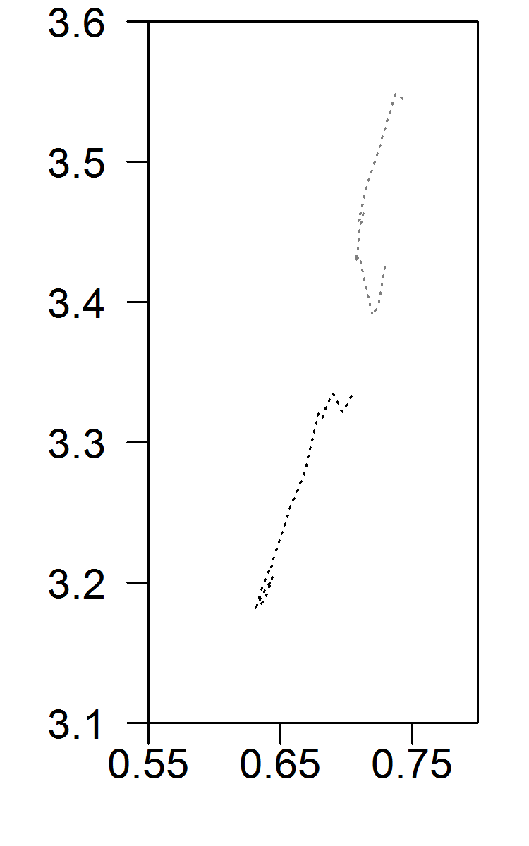
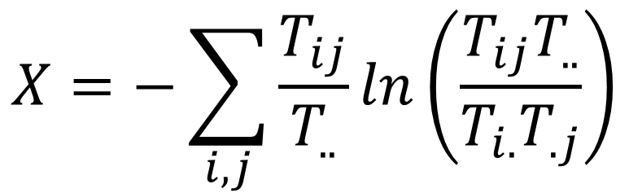
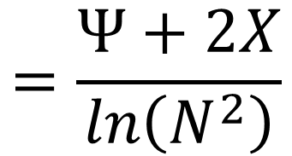
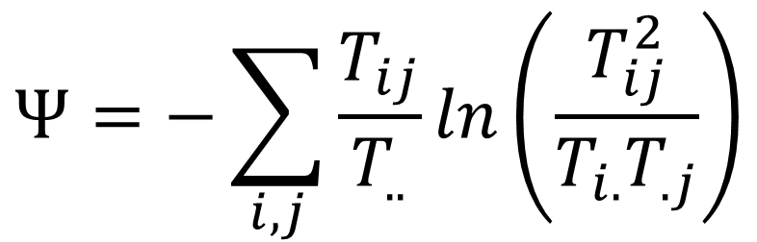
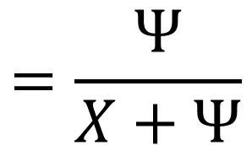
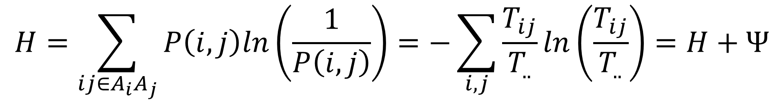
The Structure of the World Economy: Using the World Input-Output Database
Carey W. King (careyking@mail.utexas.edu, @CareyWKing)
Background
Previous Results (U.S. only: 1947-2012)
Scientists from multiple disciplines posit that the structure of complex systems is linked to the cost (or “net energy”) of and rate of resource (energy) consumption. The purpose of this research is to understand the relationship between the structure of the economy and the cost of “core” inputs of food and energy. Structure is measured via information theory metrics as used by Robert Ulanowicz to understand food webs, and as adapted by King (2016) to analyze economic input-output tables. The cost of energy and food is measured as the spending by food and energy economic sectors divided by net economic output (=gross domestic (or world) product), and the “net power ratio” is the reciprocal of that cost.
King (2016) showed three phases of structural change from 1947–2012 that relate to the rates of change of both (1) energy consumption and (2) the Net Power Ratio (= GDP / spending by food and energy sectors).
Table 1. Rate of change of information theory metrics of the U.S. I-O tables show 3 phases from 1947-2012.
Metric | Rate of Change (%/yr)
 | 1947 –1967 | 1967 –2002 | 2002 –2012
Energy Consump. | +4.1 | +1.9 | -0.3
Net Power Ratio | +2.8 | +3.4 | -1.8
Info. Entropy | +0.4 | -0.1 | -0.4
Equality | +0.3 | -0.2 | -0.2
Redundancy | +0.2 | +0.2 | -0.3
Conditional Entropy
Mutual Constraint
Figure 2. Information theory metrics of the U.S. I-O tables from 1947-2012 [King (2016)].
Data and Methodology
New Results: WIOD Release 2016: 2000-2014
The method assumes the economy is a network of flows (= sector-to-sector transactions) among nodes (sectors). Data come from the World Input-Output Database (WIOD, http://www.wiod.org/). Releases 2013 and 2016 of the WIOD respectively harmonize economic data for 41 and 44 countries across 35 and 56 sectors from 1995 to 2011 and 2000 to 2014. The information theory metrics derive from calculating mutual constraint (X) and (joint) conditional entropy (Ψ), the sum of which is total information entropy (H).
Japan
USA
(a)
USA
2000
(b)
USA
2000
(c)
USA
2000
(d)
2000
Spain
Spain
Spain
2014
Spain
Canada
China
2014
Canada
China
2014
China
Country-Level Metrics
(Boundary A)
China
2014
Canada
Canada
Brazil
Brazil
Brazil
Rest of World
Brazil
1/16 | 1/16 | 1/16 | 1/16
1/16 | 1/16 | 1/16 | 1/16
1/16 | 1/16 | 1/16 | 1/16
1/16 | 1/16 | 1/16 | 1/16
Ψ_{max} = ln(N²)
Hierarchy = 0
Equality = 1
Efficiency = 0
Redundancy = 1
Rest of World
Rest of World
Rest of World
Redundancy
Redundancy/Efficiency:
Describes flows
along edges
Figure 3. From 2000 to 2014, a higher fraction of world GDP came from countries with (a) lower net power ratio (or higher food and energy costs), (b) lower information entropy (H), (c) lower equality, and (d) lower redundancy. This trend seems largely due to globalization as the “Rest of World” and China account for much of the increased GDP since 2000 while having lower information theory metrics and net power ratio.
Hierarchy/Equality:
Describes flows through nodes
New Results: Worldwide Metrics at Different Boundaries
Conditional
Entropy (Ψ)
Hierarchy
Release 2016
Release 2013
(A)
2000
Information
Entropy
1995
Information
Entropy
2000
Equality
X_{max} = ln(N)
Hierarchy = 0
Equality = 1
Efficiency = 1
Redundancy = 0
Country Metrics weighted by GDP
(no ins & outs)
Equality
Redundancy
2002
Release 2016
 | 1
Ψ_{min} = X_{min} = 0
Hierarchy = 1
Equality = 0
Efficiency
 | 1/4
 |  | 1/4
 |  |  | 1/4
1/4
Redundancy
Equality
1995
2014
2014
(a)
2011
(b)
Release 2013
Mutual Constraint (X)
2011
Figure 1. For any set of flows within a network, T (e.g., I-O matrix for a given year), the calculated mutual constraint and conditional entropy values reside within this triangular phase space.
Equality
(C)
2000
Information Entropy:
$$H=\sum_{ij∈A_{i}A_{j}}{P\left(i,j\right)ln\left(\frac{1}{P\left(i,j\right)}\right)}=−\sum_{i,j}{\frac{T_{ij}}{T_{..}}ln\left(\frac{T_{ij}}{T_{..}}\right)=H+Ψ}$$
(C) Entire World I-O Matrix
(no ins & outs)
Equality
2000
2008
Release 2016
Worldwide Metrics at different Boundaries
Information
Entropy
2014
Conditional Entropy:
$$Ψ=−\sum_{i,j}{\frac{T_{ij}}{T_{..}}ln\left(\frac{T_{ij}^{2}}{T_{i.}T_{.j}}\right)}$$
Redundancy:
$$=\frac{Ψ}{X+Ψ}$$
Information
Entropy
1995
2014
Redundancy
(c)
2011
(d)
2011
1995
Mutual Constraint:
$$X=−\sum_{i,j}{\frac{T_{ij}}{T_{..}}ln\left(\frac{T_{ij}T_{..}}{T_{i.}T_{.j}}\right)}$$
Equality:
$$=\frac{Ψ+2X}{ln\left(N^{2}\right)}$$
Redundancy
Release 2013
Equality (0 to 1): Measures the degree to which all network nodes have the same total flow (Hierarchy = 1 – Equality).
Redundancy (0 to 1): Measures the degree to which all network edges have the same flow (Efficiency = 1 – Redundancy).
2014
Redundancy
2011
Redundancy
Release 2016
2014
Release 2016
2000
(D) Entire World I-O Matrix
(with ins & outs)
Information
Entropy
Information
Entropy
2000
Release 2013
2014
Boundaries for Analysis
Equality
Equality
2011
1995
(A) Country I-O (closed):
no “inputs” or “outputs”
 |  |  |  |  |  |  |  |  |  | ● |  |  |  |  |  |  |  |  |  |  |  |  |  | ●
 |  |  |  |  |  |  |  |  |  |  | ● |  |  |  |  |  |  |  |  |  |  |  |  | ●
 |  |  |  |  |  |  |  |  |  |  |  | ● |  |  |  |  |  |  |  |  |  |  |  | ●
 |  |  |  |  |  |  |  |  |  |  |  |  | ● |  |  |  |  |  |  |  |  |  |  | ●
(e)
2000
(f)
1995
1995
Release 2013
2011
(B) Country I-O (open):
“inputs” = Value Added + Imports
“outputs” = C + G + GCF + Δinventory + Exports
Country 1
(D)
(B)
Country 2
Food and Energy Sectors Spending (N)
Figure 4. The changing structure of the world economy follows a different path when considering different boundaries. Boundary A: (4a & 4b) The country-weighted metrics generally decline (except for redundancy before 2002). Boundary B: Metrics not shown (see Figure 5B). Boundary C: (c & d) The entire I-O matrix of the world as a single network (no inputs or outputs) shows declining information entropy and equality after the Great Recession. Boundary D: (e & f) Information entropy and equality are generally up after 2002 (peak net power ratio) with the opposite trend for redundancy. Compared to Boundary C (no inputs and outputs), equality is significantly lower, and redundancy is similar.
Figure 5. Plot of the overall world economy Conditional Entropy (Ψ) versus Mutual Constraint (X) at different system boundaries (A) – (D).
Consumption, Govt., Capital Formation, ΔInventory (2)
Consumption, Govt., Capital Formation, ΔInventory (1)
(C) Entire World I-O (closed):
no “inputs” or “outputs”
Food and Energy Sectors Spending (1)
Consumption, Govt., Capital Formation, ΔInventory (N)
(D) Entire World I-O (open):
“inputs” = Value Added,
“outputs” = C + G + GCF + ΔInventory
Food and Energy Sectors Spending (2)
“Open” boundary calculations add this quantity, O, to X and Ψ, and thus 2O to H:
Country N
Conclusions
O$=−\sum_{j}{\frac{T_{input,j}}{T_{..}}ln\left(\frac{T_{input,j}}{T_{.j}}\right)}−\sum_{i}{\frac{T_{i,output}}{T_{..}}ln\left(\frac{T_{i,output}}{T_{i.}}\right)}$
References
Value Added (i.e., wages, profits, taxes)
World net power ratio decrease after 1998-2002 (time of maximum) as analyzed by all boundaries and both data releases.
Countries are generally experiencing more concentrated flows of money (lower equality and redundancy) while the world overall experiences the opposite.
The boundaries for calculating global metrics show different trends.
The GDP-weighted metrics (H, equality, redundancy) have a general declining trend independent of net power ratio.
At the entire World I-O Boundary, trends are different before vs. after the Great Recession (2008): equality and information entropy went from increasing to decreasing, and redundancy went from decreasing to increasing.
Blah blah …
King, Carey W. (2016) Information Theory to Assess Relations Between Energy and Structure of the U.S. Economy Over Time. Biophysical Economics and Resource Quality, 1 (2).
Timmer, M. P., Dietzenbacher, E., Los, B., Stehrer, R. and de Vries, G. J. (2015), An Illustrated User Guide to the World Input–Output Database: the Case of Global Automotive Production, Review of International Economics, 23: 575–605.
Ulanowicz, R.E., Goerner S.J., Lietaer B., Gomez R. (2009) Quantifying sustainability: resilience, efficiency and the return of information theory. Ecological Complexity, 6 (1):27.

Slide 6
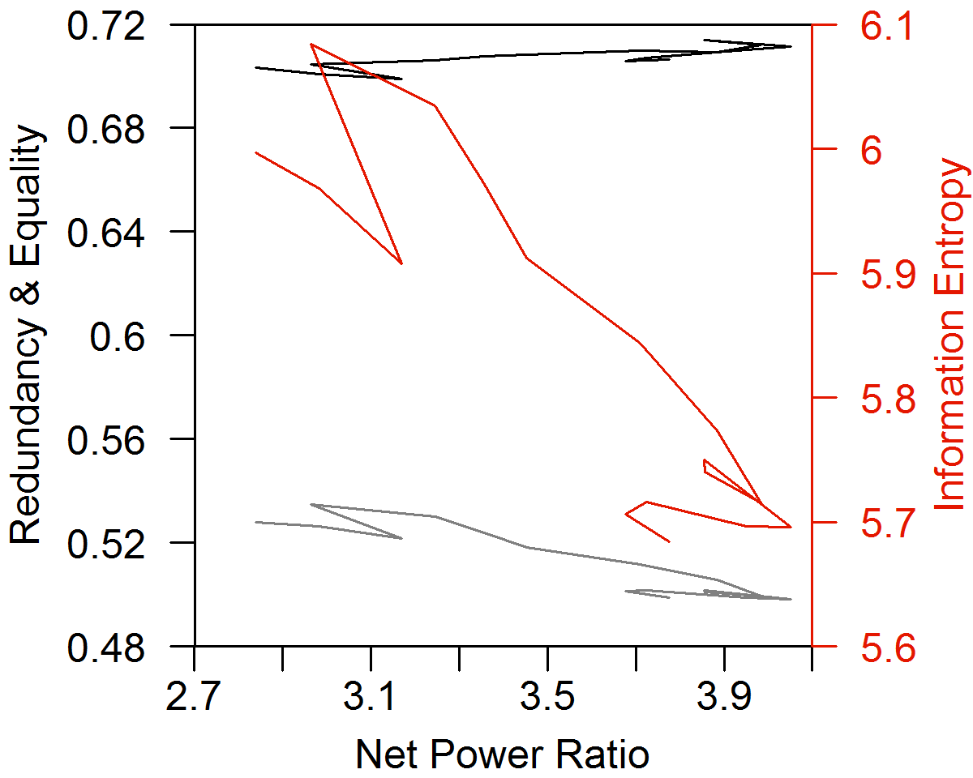
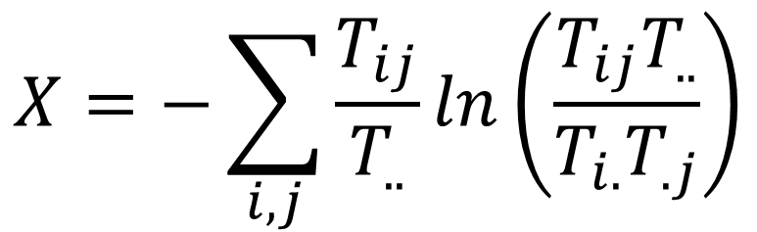
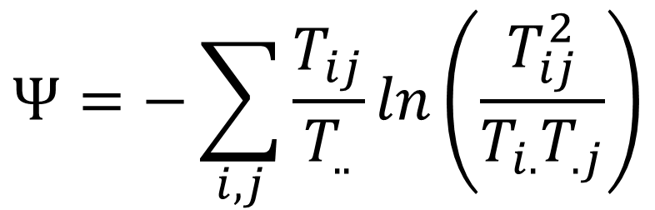
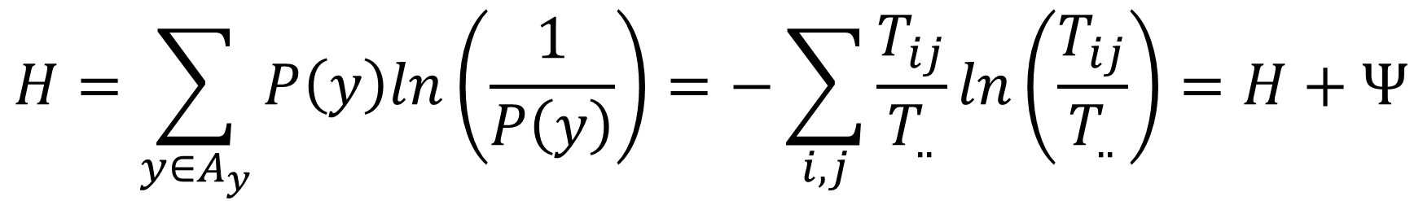
The Structure of the World Economy: Using the World Input-Output Database
Carey W. King (careyking@mail.utexas.edu, @CareyWKing)
Background
Previous Results (U.S. only: 1947-2012)
Scientists from multiple disciplines posit that the structure of complex systems is linked to the cost (or “net energy”) of and rate of resource (energy) consumption. The purpose of this research is to understand the relationship between the structure of the economy and the cost of “core” inputs of food and energy. Structure is measured via information theory metrics as used by Robert Ulanowicz to understand food webs, and as adapted by King (2016) to analyze economic input-output tables. The cost of energy and food is measured as the spending by food and energy economic sectors divided by net economic output (=gross domestic (or world) product), and the “net power ratio” is the reciprocal of that cost.
King (2016) showed three phases of structural change from 1947–2012 that relate to the rates of change of both (1) energy consumption and (2) the Net Power Ratio (= GDP / spending by food and energy sectors).
Table 1. Rate of change of information theory metrics of the U.S. I-O tables show 3 phases from 1947-2012.
Metric | Rate of Change (%/yr)
 | 1947 –1967 | 1967 –2002 | 2002 –2012
Energy Consump. | +4.1 | +1.9 | -0.3
Net Power Ratio | +2.8 | +3.4 | -1.8
Info. Entropy | +0.4 | -0.1 | -0.4
Equality | +0.3 | -0.2 | -0.2
Redundancy | +0.2 | +0.2 | -0.3
Conditional Entropy
Mutual Constraint
Figure 2. Information theory metrics of the U.S. I-O tables from 1947-2012 [King (2016)].
Data and Methodology
New Results: WIOD Release 2016: 2000-2014 (closed boundary )
The method assumes the economy is a network of flows (= sector-to-sector transactions) among nodes (sectors). Data come from the World Input-Output Database (WIOD, http://www.wiod.org/). Releases 2013 and 2016 of the WIOD respectively harmonize economic data for 41 and 44 countries across 35 and 56 sectors from 1995 to 2011 and 2000 to 2014. The information theory metrics derive from calculating mutual constraint (X) and (joint) conditional entropy (Ψ), the sum of which is total information entropy (H).
Japan
USA
(a)
USA
2000
(b)
USA
2000
(c)
USA
2000
(d)
2000
Spain
Spain
Spain
Country Metrics
2014
Spain
Canada
China
2014
Canada
China
2014
China
China
2014
Canada
Canada
Brazil
Brazil
Brazil
Rest of World
Brazil
1/16 | 1/16 | 1/16 | 1/16
1/16 | 1/16 | 1/16 | 1/16
1/16 | 1/16 | 1/16 | 1/16
1/16 | 1/16 | 1/16 | 1/16
Ψ_{max} = ln(N²)
Hierarchy = 0
Equality = 1
Efficiency = 0
Redundancy = 1
Rest of World
Rest of World
Rest of World
Redundancy
Redundancy/Efficiency:
Describes flows
along edges
Figure 3. From 2000 to 2014, a higher fraction of world GDP came from countries with (a) lower net power ratio (or higher food and energy costs), (b) lower information entropy (H), (c) lower equality, and (d) lower redundancy. This trend seems largely due to globalization as the “Rest of World” and China account for much of the increased GDP since 2000 while having lower information theory metrics and net power ratio.
Hierarchy/Equality:
Describes flows through nodes
Release 2016
Release 2013
Conditional
Entropy (Ψ)
Hierarchy
Equality
(b)
2000
(a)
Equality
Entire World I-O Matrix
Equality
2000
Information
Entropy
Release 2016
 | 1
Efficiency
X_{max} = ln(N)
Hierarchy = 0
Equality = 1
Efficiency = 1
Redundancy = 0
 | 1/4
 |  | 1/4
 |  |  | 1/4
1/4
Information
Entropy
2014
Ψ_{min} = X_{min} = 0
Hierarchy = 1
Equality = 0
2014
Redundancy
2011
1995
2011
1995
Mutual Constraint (X)
(a)
Redundancy
(b)
Release 2013
Replace with new open world I-O calculations
Figure 1. For any set of flows within a network, T (e.g., I-O matrix for a given year), the calculated mutual constraint and conditional entropy values reside within this triangular phase space.
Worldwide Metrics
2000
Information
Entropy
Information
Entropy
(c)
Information Entropy:
$$H=\sum_{y∈A_{y}}{P\left(y\right)ln\left(\frac{1}{P\left(y\right)}\right)}=−\sum_{i,j}{\frac{T_{ij}}{T_{..}}ln\left(\frac{T_{ij}}{T_{..}}\right)=H+Ψ}$$
Equality
1995
2002
Release 2016
2000
Conditional Entropy:
$$Ψ=−\sum_{i,j}{\frac{T_{ij}}{T_{..}}ln\left(\frac{T_{ij}^{2}}{T_{i.}T_{.j}}\right)}$$
$$=\frac{Ψ}{X+Ψ}$$
Country I-O Data weighted by GDP
Redundancy
2014
Redundancy:
Redundancy
Equality
1995
Calculations using net output as an outflow and value added as an inflow (specifics not shown)
Mutual Constraint:
$$X=−\sum_{i,j}{\frac{T_{ij}}{T_{..}}ln\left(\frac{T_{ij}T_{..}}{T_{i.}T_{.j}}\right)}$$
Equality:
$$=\frac{Ψ+2X}{ln\left(N^{2}\right)}$$
2014
(c)
2011
(d)
Release 2013
2011
Equality (0 to 1): Measures the degree to which all network nodes have the same total flow (Hierarchy = 1 – Equality).
Redundancy (0 to 1): Measures the degree to which all network edges have the same flow (Efficiency = 1 – Redundancy).
2016:
Redundancy and Equality vs. NPR
(Entire I-O matrix)
Needs to be recalculated as of 7/7/18
Redundancy
Psi vs. X for open bound. (entire I-O matrix)
May need to redo country-specific open calculations too?
2014
Redundancy
2002
Information
Entropy
Information
Entropy
(A) Country I-O Level:
no “inputs” or “outputs”
 |  |  |  |  |  |  |  |  |  | ● |  |  |  |  |  |  |  |  |  |  |  |  |  | ●
 |  |  |  |  |  |  |  |  |  |  | ● |  |  |  |  |  |  |  |  |  |  |  |  | ●
 |  |  |  |  |  |  |  |  |  |  |  | ● |  |  |  |  |  |  |  |  |  |  |  | ●
 |  |  |  |  |  |  |  |  |  |  |  |  | ● |  |  |  |  |  |  |  |  |  |  | ●
Equality
Equality
1995
Country 1
(e)
2000
(f)
Boundaries for Analysis
(B) Entire World I-O Level:
no “inputs” or “outputs”
Country 2
Food and Energy Sectors Spending (N)
Figure 4. The changing structure of the world economy follows a different path when considering different boundaries. (a & b) the entire I-O matrix of the world (all countries, imports, and exports as a single network) versus (c & d) the weighted average of the metrics for each country’s I-O matrix. Both perspectives show generally decreasing net power ratio since ~2000. (
Figure 5. (a) Plot of the overall world economy Conditional Entropy (Ψ) versus Mutual Constraint (X) with different system boundaries. (b) shows the calculation when using the entire WIOD world table (with imports and exports) as a single matrix, and (c) shows the calculation as a GDP-weighted average of each country’s metrics.
Consumption, Govt., Capital Formation, ΔInventory (2)
Consumption, Govt., Capital Formation, ΔInventory (1)
Food and Energy Sectors Spending (1)
Consumption, Govt., Capital Formation, ΔInventory (N)
(C) Entire World I-O Level:
“inputs” = Value Added,
“outputs” = C + G + GCF + ΔInventory
Food and Energy Sectors Spending (2)
Country N
Conclusions
References
Value Added
Maximum world net power ratio is between 1998-2002 as analyzed by both boundaries and data releases.
The two boundaries for calculating global metrics show different trends.
The GDP-weighted metrics (information entropy, equality, redundancy) have a general declining trend independent of net power ratio.
At the entire World I-O Boundary, trends are different before vs. after the Great Recession (2008): equality and information entropy went from increasing to decreasing, and redundancy went from decreasing to increasing.
King, Carey W. (2016) Information Theory to Assess Relations Between Energy and Structure of the U.S. Economy Over Time. Biophysical Economics and Resource Quality, 1 (2).
Timmer, M. P., Dietzenbacher, E., Los, B., Stehrer, R. and de Vries, G. J. (2015), An Illustrated User Guide to the World Input–Output Database: the Case of Global Automotive Production, Review of International Economics, 23: 575–605.
Ulanowicz, R.E., Goerner S.J., Lietaer B., Gomez R. (2009) Quantifying sustainability: resilience, efficiency and the return of information theory. Ecological Complexity, 6 (1):27.

